Slide 1
IPv6-based IFIT(In-situ Flow Information Telemetry) and Enhancement of IPv6 Extension Header draft-li-6man-ipv6-sfc-ifit-01 draft-li-6man-enhanced-extension-header-00 Tianran Zhou (Huawei)
IETF105@Montreal

Slide 2

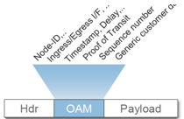
SRv6/IPv6 IFIT (In-situ Flow Information Telemetry)
IPv6 HDR
In/Out TS1
In/Out TS2
Payload
B
IPv6 HDR
In/Out TS1
In/Out TS2
In/Out TS3
In/Out TS4
Payload
IPv6 HDR
In/Out TS1
Payload
A
D
IPv6 HDR
In/Out TS1
In/Out TS2
In/Out TS3
Payload
C
IFIT Framework: draft-song-opsawg-ifit-framework-01
SRv6 In-situ OAM: draft-ali-6man-spring-srv6-oam-01
IPv6 IFIT/IOAM: draft-li-6man-ipv6-sfc-ifit-00 IETF104@Prague
Notes:
Robin：
1. 跟陈国义商量一下，我们在解决5G承载中的技术积累，包括OAM、分片、低时延等。

Slide 3
Consideration of IPv6 Encapsulation for Path Services draft-li-6man-ipv6-sfc-ifit-01
Path services such as IOAM and SFC need a Metadata field to record its metadata information
Currently these metadata have to be recorded separately which may generate redundant metadata information or increase the cost of process
In the incremental tracing mode of IOAM, as the number of nodes traversed by the IPv6 packets increases, the recorded IOAM information will increase accordingly, which will increase the length of the Metadata field.
If the IPv6 MH is placed before RH (SRH for SRv6), it will cause increasing difficulties in reading the following SRH and thereby reduce the forwarding performance of the data plane greatly.

Slide 4
Instruction and Recording are separated
The instruction part (uniform IPv6 service option)
Placed in the front IPv6 extension headers including HBH, RH, etc.
either in the HBH indicating the path service processed by all IPv6 enabled nodes along the path
or in the SRH TLVs indicating the path service processed only by the SRv6 nodes along the SRv6 path
fixed as much as possible to facilitate hardware process to keep forwarding performance
The recording part (unified container)
to record the service metadata of SFC, IFIT and other possible path services
enables to stop recording when too much data carried to reach the hardware limitation

Slide 5
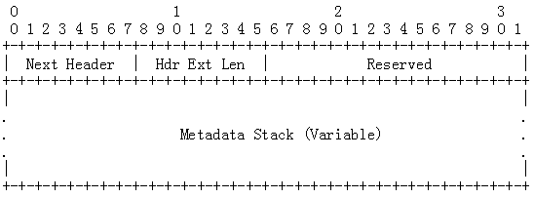
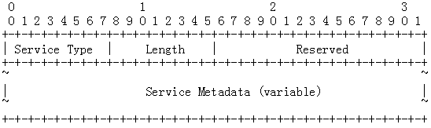
IPv6 Metadata Header
A unified metadata header, IPv6 Metadata Header (MH), is defined as a container to record the metadata of SFC, IOAM and other newly emerging path services in IPv6.
The IPv6 Metadata Header is defined as a new type of IPv6 extension header, which is identified by a Next Header value (TBD_2).
The metadata is the information recorded by each hop for specific path services.
The length of the metadata is variable.

Slide 6
Next steps
Questions and Comments are welcome
Consolidate comments
Refine drafts

Slide 7
Thank you!

Slide 8
Content
Enhanced Hop-by-Hop Options Header
Consideration and Optimization of IPv6 Encapsulation for Path Services, e.g. IOAM and APN6
IPv6 Metadata Header
Processing Procedures for Handling IPv6 Metadata Header
Interactions between IPv6 Metadata Header and Existing IPv6 Extension Headers
Authentication Header
ESP Header
Fragment Header

Slide 9
Motivations
Currently, due to lack of service requirements as well as limited the hardware processing capabilities, the HBH Options are usually dispatched to CPU or ignored
Reduce the forwarding performance greatly
Damage the end-to-end service consistency due to the different handling of various vendors
More and more services require to process the information carried in the packets or write metadata into the packets in a hop-by-hop behavior but at wire speed
IOAM
Application-aware IPv6 Networking
SFC
Hardware processing capabilities have been improving
The existing specs such as [RFC8200] and [RFC6564] only define that
nodes may be configured to ignore the Hop-by-Hop Options header (HBH)
the packets containing a HBH may be dropped
the packets containing a HBH may be assigned to a slow processing path
Can we solve it only by configuration?
All the HBH options will be treated in the same way, however, they may have different processing requirements
Every option needs to be checked one by one and decide how to process against the pre-configuration

Slide 10
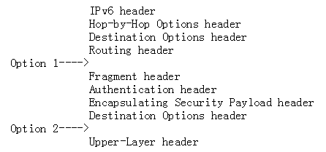
The locations for the IPv6 Metadata header
If the IPv6 MH is placed before RH (SRH for SRv6), it will cause increasing difficulties in reading the following SRH and thereby reduce the forwarding performance of the data plane greatly.
Two options in the IPv6 extension headers are recommended for inserting the IPv6 MH.
The different locations for inserting the IPv6 MH will also impact the processing of the AH, ESP, and FH, which will be discussed in the following section.
MH is changing and not predictable

Slide 11
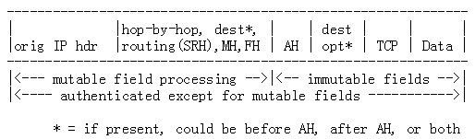
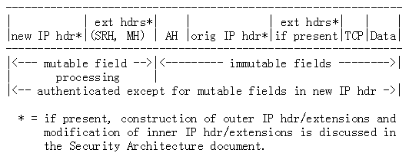
Interactions between IPv6 MH and AH [RFC4302]
Transport Mode Processing
Tunnel Mode Processing

Slide 12
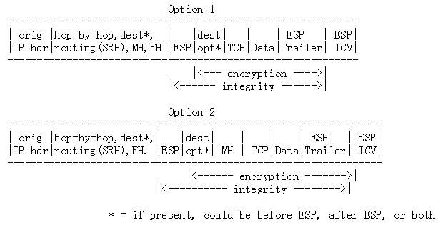
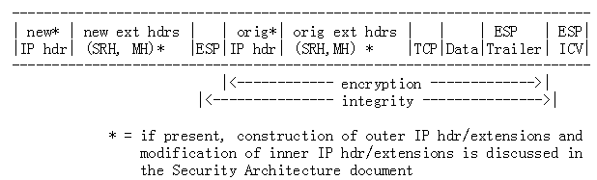
Interactions between IPv6 MH and ESP [RFC4303]
Transport Mode Processing
Tunnel Mode Processing

Slide 13
Interactions between IPv6 MH and Fragment Header
When the IPv6 Metadata is presented, the processing of FH needs to be specified.
In AH/ESP transport mode, for "bump-in-the-stack" or "bump-in- the-wire" implementations, inbound and outbound IP fragments may require an IPsec implementation to perform extra IP reassembly/fragmentation in order to both conform to this specification and provide transparent IPsec support.
Special care is required to perform such operations within these implementations when multiple interfaces are in use.

